Slide 1
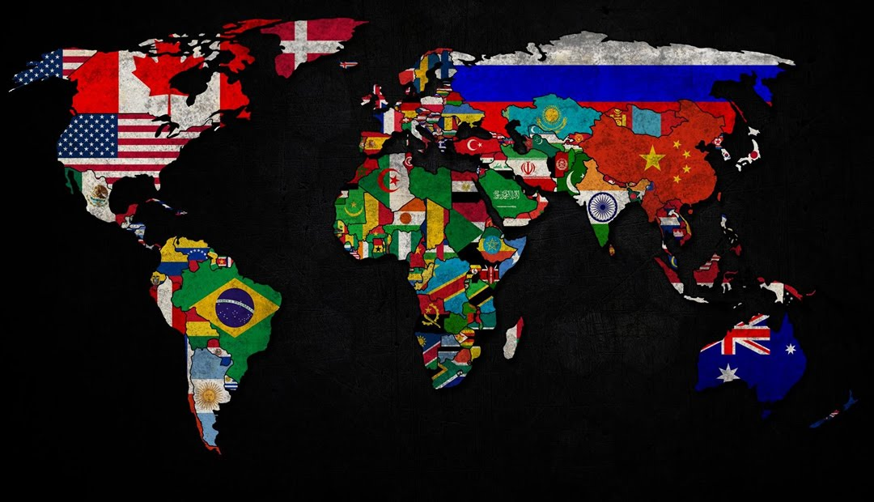
Physical and Political Geography of the World

Slide 2
Self-Assessment Activity NOTE: A mapping activity and formal quiz of all information on this presentation will follow lecture on Wednesday of next week – 21 August 2019.
1. Identify how many internationally and diplomatically recognized countries there are on Earth.
2. List the names of all continents on Earth.
3. List the names of all oceans on Earth.
4. List as many of the major seas on Earth that you know.

Slide 3
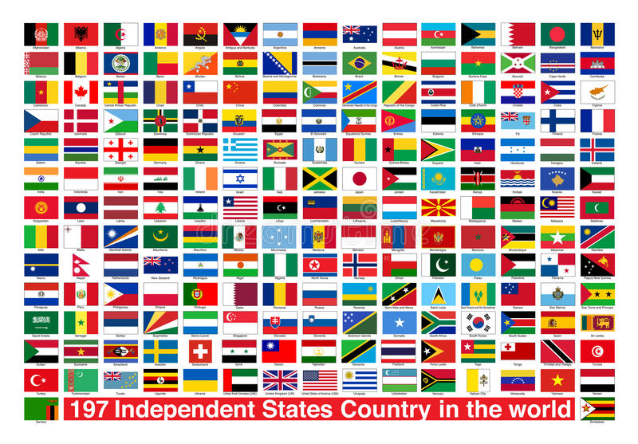
Countries
197 self-governed, independent countries with international diplomatic recognition and sovereignty
193 countries fully recognized by United Nations
Vatican City (Rome) and Palestine have permanent observer status on United Nations
Kosovo – a disputed territory and Balkan state south of Serbia: recognized by 111 UN member states
Taiwan – located off the coast of China: recognized by 22 UN member states

Slide 4
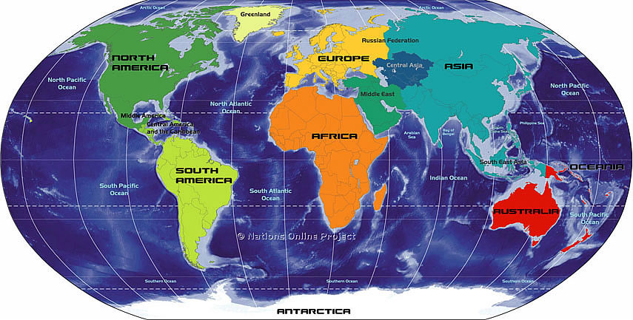
Continents
7 Continents
There is debate.
Africa
Antarctica
Asia
Australia
Europe
North America
South America

Slide 5
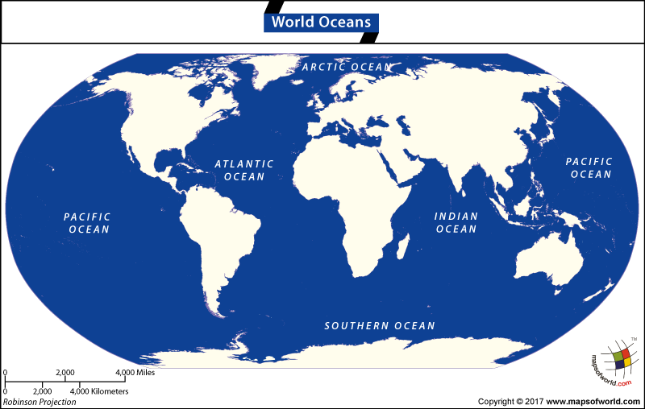
Oceans
5 Oceans
Arctic
Atlantic
Indian
Pacific
Southern

Slide 6
Major Seas of the World
The Seven Seas:
Adriatic
Arabian
Black
Caspian
Mediterranean
Persian
Red
Aegean and Baltic Seas: important trading routes

Slide 7
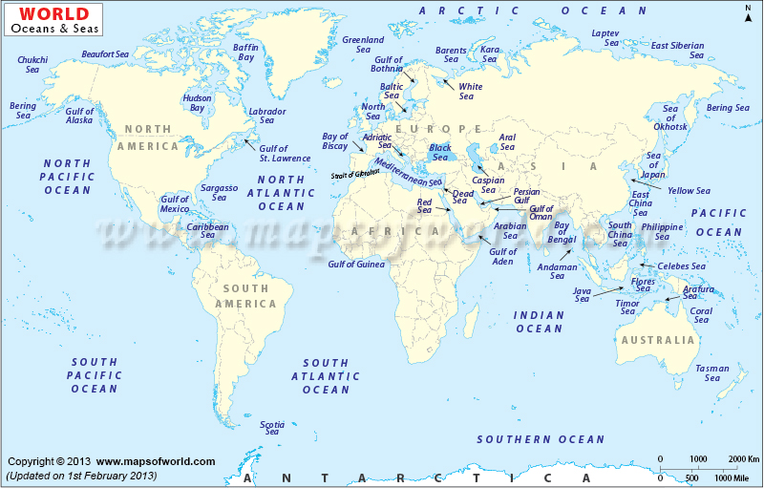

Slide 8
Self-Assessment: Europe, Russia and Asia
Identify a geographic boundary or boundaries that divide the European continent from Asia.
Identify what continent Russia belongs to: Europe or Asia?
Identify the single name given to both continents.

Slide 9
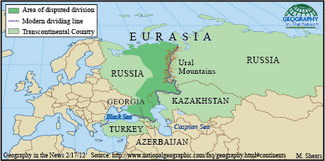
Mapping the Divide of Eurasia
Contemporary Europe-Asia boundary from south to north:
Follows the Aegean Sea
To the Dardanelles-Sea
To the Black Sea
Through the Greater Caucasus
To the northwestern portion of the Caspian Sea
Along the Ural River and Ural Mountains.

Slide 10
Mapping The Divide of Eurasia

Slide 11
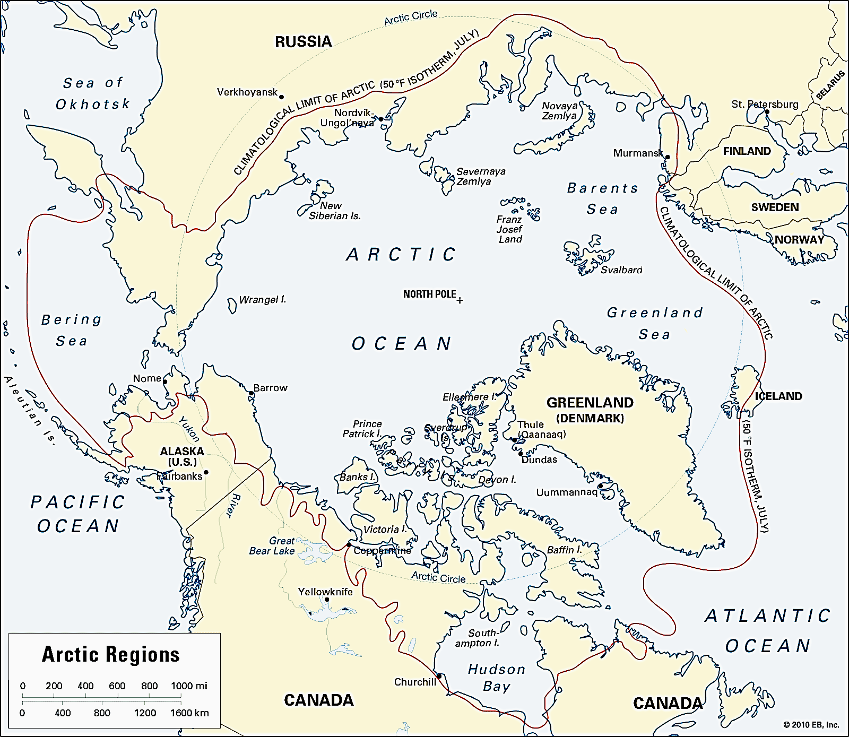
The North Passage: The World’s Next Disputed Region?

