Slide 1
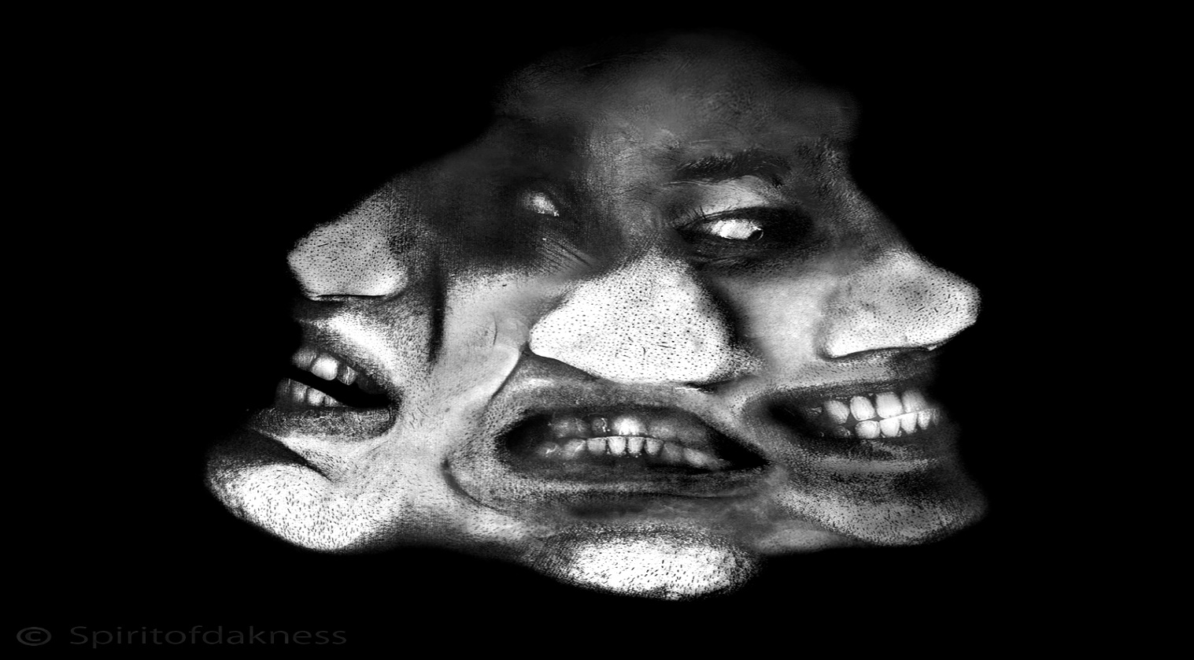
Sigmund Freud’s Personality Divisions
The ID, Ego, and Superego

Slide 2
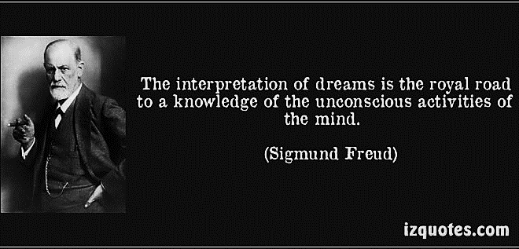
Sigmund Freud
Psychoanalyst
Studied the unconscious mind and how it affects human behavior
Believed dreams allow the unconscious mind to release itself
Purpose of dreams: They satisfy through fantasy the instinctive urges that society judges unacceptable

Slide 3
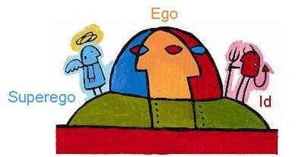
Personality’s Three Divisions
Id
Completely unconscious and primitive
A holding place for your instinctual and biological urges
Operates under the “pleasure principal”
Seeks immediate gratification of desires
Disregards consequences

Slide 4
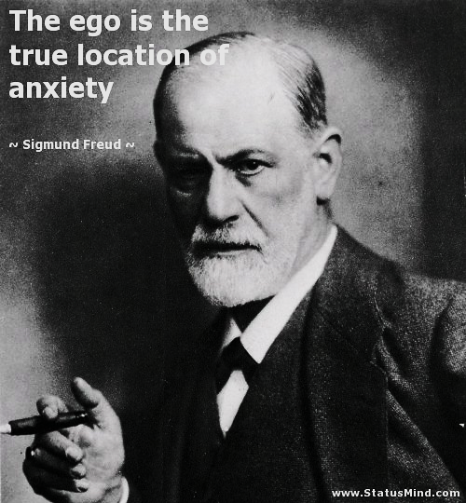
Ego
Serves as the organized mediator between you and reality
Rational – not instinctual
Operates under the “Reality Principal”
Restrains the instinctual Id to maintain safety of the person

Slide 5
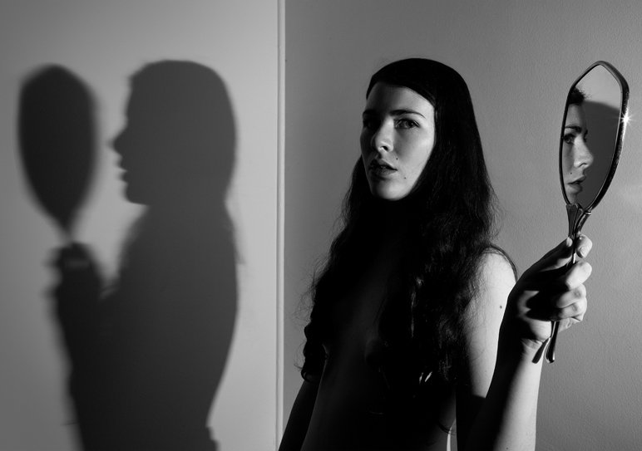
Superego
Partly conscious
Represents:
A parental conscience
The rules of society, morality
Societal pressures (tells us what is right or wrong)

Slide 6
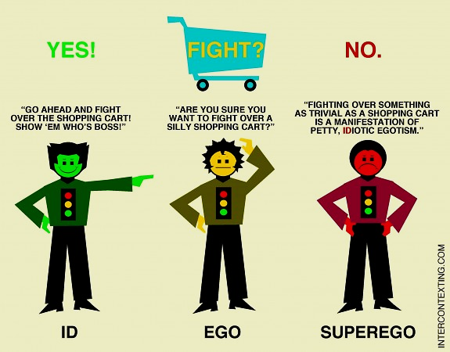

Slide 7
Identify the part of Freud’s personality divisions that have taken over the passengers of this vehicle.

